Slide 1
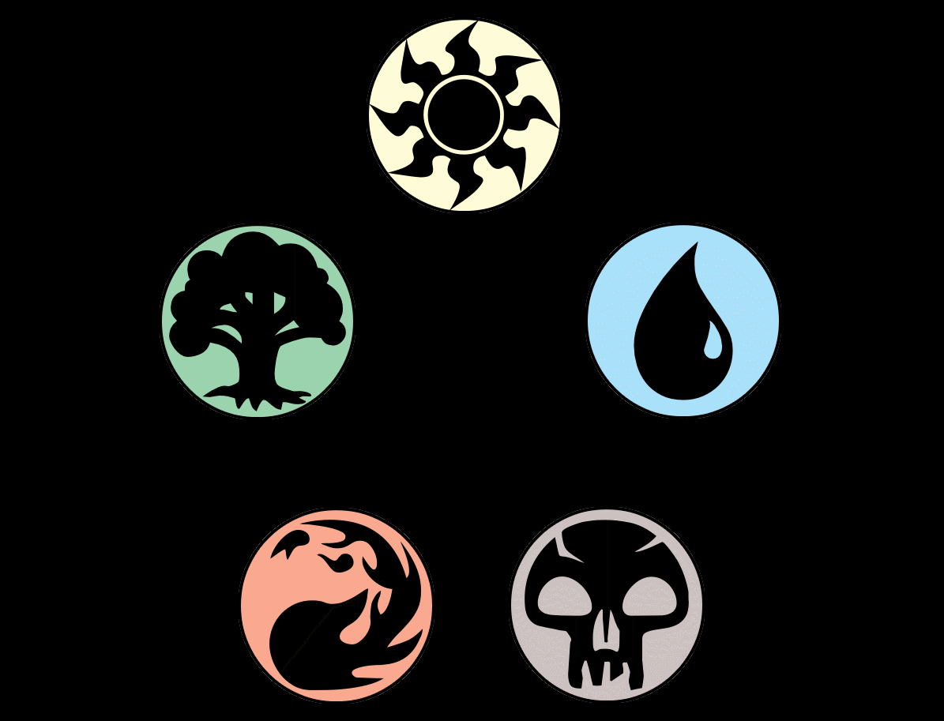

Binary Image Classification: Magic the Gathering Tokens
By: Gabriel Valdes
Ironhack RMT-DAPT-Oct2023

Slide 2
Introduction – Magic the Gathering
Magic the Gathering (MTG) is a fantasy-based strategy card game available in paper and digital formats produced by Wizards of the Coast (WotC).
There are over 25,000 cards printed in the 30+ year history of the game.
The vast majority of these cards are “play cards” which players use to construct their decks.
In 2003, WotC began to print “token” cards which are temporary game-pieces created by in-game effects.
Notes:
Came out in 1993. WotC now owned by Hasbro.
25000 cards over released 100 sets, of which several are released in a year.
In recent history, MTG has increased its share in the trading card game market by collaborating with different Ips across many different genres. For example (within its own genre) there have been cross overs with other tabletop games such as Warhammer and Dungeon and Dragon sets. Moreover, there have been special sets and cards that feature Transformers, Jurassic Park, Street Fighter, Stranger Things and even Princess Bride.

Slide 3
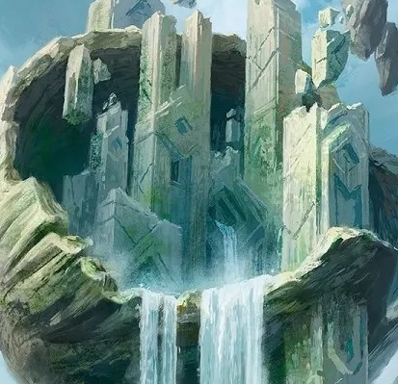
Business Case
Recently hired at startup online retailer for MTG as data scientist.
The business is buying as many cards as possible in bulk from eBay and similar platforms.
In the thousands of cards purchased, many will be tokens which are not as highly valued as they are not used to construct decks.
The business scans the newly purchased card and has enlisted me to create a classification model to be able to tell what in their stock is a play card versus a token.

Slide 4
Approach
Gather images of play cards and token images
Load and arrange images into training and testing data sets and then apply digital transformations to the images
Define an image classification model and determine the accuracy of the model
Use predefined models to compare accuracy to my own
Attain more images of different types of cards to test the accuracy of each model

Slide 5
Gathering Card Images
Technique used: Webscraping
Website: Scryfall.com search result page(s)
Results for “token” type of cards (13 pages)
Results for “commander legal” play cards (444 pages)
Images were saved locally to specified test and train folders using Python code.
Notes:
Web scraping is the process of collecting and parsing raw data from a web site’s HTML code. Using the Inspect feature of my browser I was able to locate the hosted URL of each image on the search result page in the HTML code. My function would take the URLs, read the image and save it as a local file on my PC. I used a library called “os” to also create folders within the test and train folders for each subset of image (token vs play card) and move the respective images to the correct folder.

Slide 6
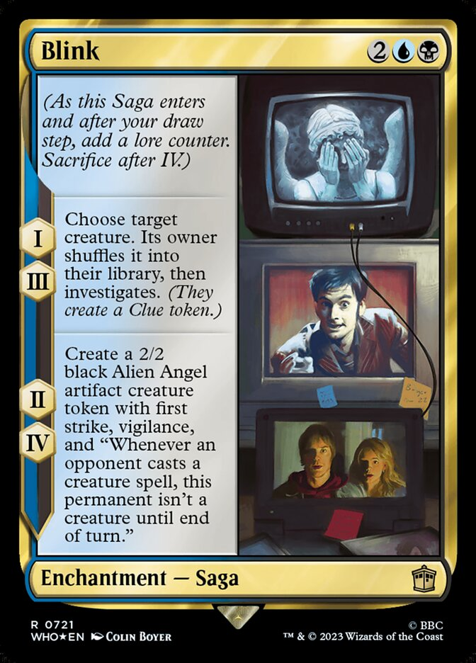
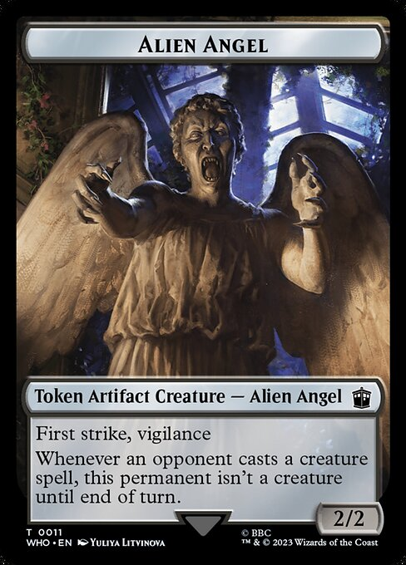
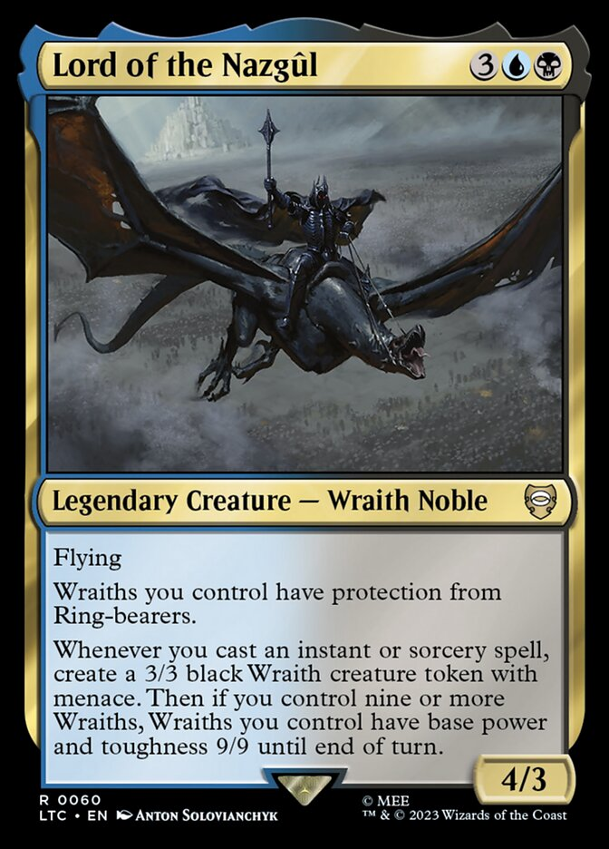
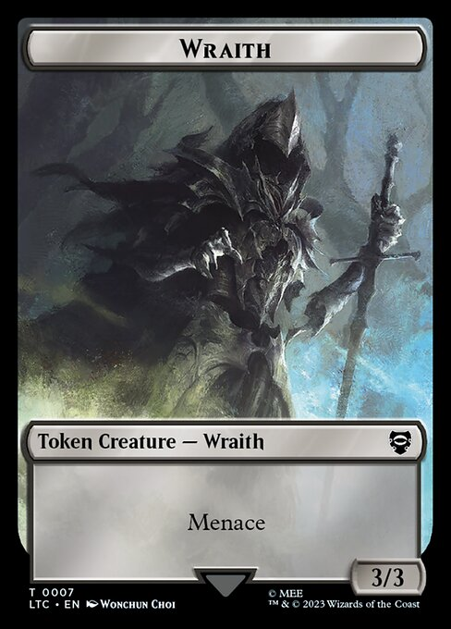
Gathering Card Images
Result:
Play Card images: 2,100
Token Images: 698
Notes:
Totals : 2100+ play, 698 tokens
To demonstrate what I mean when talking about play cards vs tokens I provided these images here from real MTG cards. The 1st pair show cards from the Dr. Who set released last year. The image on the left is a play card named “Blink”. You can see that it has things like a “mana cost”, which must be paid in-game in order to cast the spell (or use the card). If we focus on the last paragraph, you can see that the card’s ability allows the player to “create a 2/2 black Angel Alien artifact token” with various abilities, which you can see is the next image. This token card has no mana cost (because players cannot cast this card, it can only be created by another card’s effect). This is one of the main differences between the cards and one of the nuisances that my model can use to determine whether a given image is of a token or play card. Moving on to our other example, another main distinction is in the “type line” of the cards. Lord of the Nazgul has Legendary Creature as its super type and Wraith Noble subtype. All token cards, contain the super type “token:.

Slide 7
Fixing Data Imbalance
Data Imbalance: The bias that exists when one class of data outnumbers another class which may lead to an inaccurate model.
Tokens only made up about 24% of all the images
Notes:
Based on the results from the previous slide, it is easy to see that there was a high data imbalance. I had extracted every single printed token card image and had about 700 records, however I had over 3 times the amount of play card images only scraping about 30 pages of play card search results. This means that my model could learn more easily about features of play cards than token cards since there were more present in my data set.

Slide 8
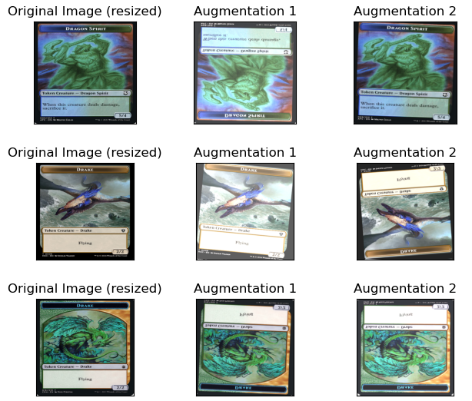
Data Augmentation
Digital Augmentation: Applying various effects to images allowed me to randomly adjust basic attributes of the image like:
contrast and brightness.
vertical flipping, rotation, zoom and crop.
Final training data set size: 2,849 images
Scraped Play Card images: 1,487 ( + 28%)
Scraped Token Images: 1,362 (+ 200%)
Notes:
Another problem I wanted to solve was card quality. It is completely plausible that during the bulk purchases of the cards there would vastly differing quality of cards purchased, for example, brand new cards, faded cards, scratched cards, bent cards, etc. One more “real world” aspect I wanted to account for was how scanning the images might not always be uniform, some may be fed into the scanner upside down, or slightly off axis. I was able to solve the imbalance problem and card/scan quality problem by using digital augmentation. I used this technique to build up the training data from the images I captured: for each token image I stored 3 copies of the image, two with differing sets of random augmentation and then the original. For the play cards, I augmented only a fraction of the images I was constructing my test data from. Here are the results of the custom data image augmentation I did. I was able to increase my token image samples by 200% and fixed the data imbalance present in my training data.
You can also see here an example of how the augmentations affected the images

Slide 9
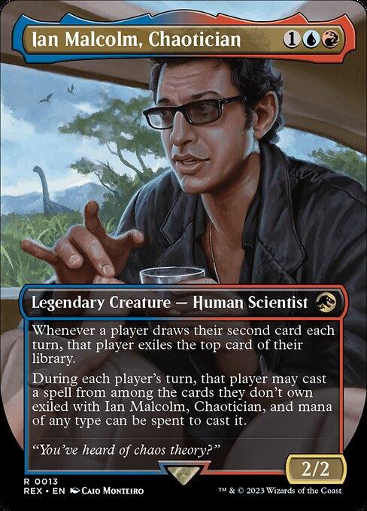
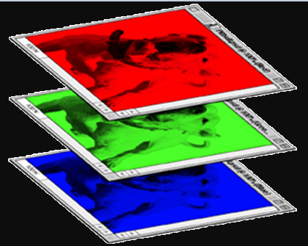
Images as Data
Machine Learning cannot be achieved from visually interpreting images as humans can. Instead, the images are converted into arrays of data, and the machine learns patterns from these arrays.
488
1 | 0 | 0 | 0 | 0 | 1
0 | 1 | 0 | 0 | 1 | 0
0 | 0 | 1 | 1 | 0 | 0
1 | 0 | 0 | 0 | 1 | 0
0 | 1 | 0 | 0 | 1 | 0
0 | 0 | 1 | 0 | 1 | 0
366
Color image
1 | 0 | 0 | 0 | 0 | 1
0 | 1 | 0 | 0 | 1 | 0
0 | 0 | 1 | 1 | 0 | 0
1 | 0 | 0 | 0 | 1 | 0
0 | 1 | 0 | 0 | 1 | 0
0 | 0 | 1 | 0 | 1 | 0
1 | 0 | 0 | 0 | 0 | 1
0 | 1 | 0 | 0 | 1 | 0
0 | 0 | 1 | 1 | 0 | 0
1 | 0 | 0 | 0 | 1 | 0
0 | 1 | 0 | 0 | 1 | 0
0 | 0 | 1 | 0 | 1 | 0
1 | 0 | 0 | 0 | 0 | 1
0 | 1 | 0 | 0 | 1 | 0
0 | 0 | 1 | 1 | 0 | 0
1 | 0 | 0 | 0 | 1 | 0
0 | 1 | 0 | 0 | 1 | 0
0 | 0 | 1 | 0 | 1 | 0
1 | 0 | 0 | 0 | 0 | 1
0 | 1 | 0 | 0 | 1 | 0
0 | 0 | 1 | 1 | 0 | 0
1 | 0 | 0 | 0 | 1 | 0
0 | 1 | 0 | 0 | 1 | 0
0 | 0 | 1 | 0 | 1 | 0
1 | 0 | 0 | 0 | 0 | 1
0 | 1 | 0 | 0 | 1 | 0
0 | 0 | 1 | 1 | 0 | 0
1 | 0 | 0 | 0 | 1 | 0
0 | 1 | 0 | 0 | 1 | 0
0 | 0 | 1 | 0 | 1 | 0
1 | 0 | 0 | 0 | 0 | 1
0 | 1 | 0 | 0 | 1 | 0
0 | 0 | 1 | 1 | 0 | 0
1 | 0 | 0 | 0 | 1 | 0
0 | 1 | 0 | 0 | 1 | 0
0 | 0 | 1 | 0 | 1 | 0
1 | 0 | 0 | 0 | 0 | 1
0 | 1 | 0 | 0 | 1 | 0
0 | 0 | 1 | 1 | 0 | 0
1 | 0 | 0 | 0 | 1 | 0
0 | 1 | 0 | 0 | 1 | 0
0 | 0 | 1 | 0 | 1 | 0
1 | 0 | 0 | 0 | 0 | 1
0 | 1 | 0 | 0 | 1 | 0
0 | 0 | 1 | 1 | 0 | 0
1 | 0 | 0 | 0 | 1 | 0
0 | 1 | 0 | 0 | 1 | 0
0 | 0 | 1 | 0 | 1 | 0
680
366
1 | 0 | 0 | 0 | 0 | 1
0 | 1 | 0 | 0 | 1 | 0
0 | 0 | 1 | 1 | 0 | 0
1 | 0 | 0 | 0 | 1 | 0
0 | 1 | 0 | 0 | 1 | 0
0 | 0 | 1 | 0 | 1 | 0
1 | 0 | 0 | 0 | 0 | 1
0 | 1 | 0 | 0 | 1 | 0
0 | 0 | 1 | 1 | 0 | 0
1 | 0 | 0 | 0 | 1 | 0
0 | 1 | 0 | 0 | 1 | 0
0 | 0 | 1 | 0 | 1 | 0
1 | 0 | 0 | 0 | 0 | 1
0 | 1 | 0 | 0 | 1 | 0
0 | 0 | 1 | 1 | 0 | 0
1 | 0 | 0 | 0 | 1 | 0
0 | 1 | 0 | 0 | 1 | 0
0 | 0 | 1 | 0 | 1 | 0
Notes:
The image has its color layers separated and each pixel is then converted into a value between 0 and 255 depending on the pigment on the pixel (255 being the most saturated) within he array. The shape or dimensions of the data array (which can be thought of the number of rows and columns on a spreadsheet) is made from resolution of the image (or pixel count) and color channels. For example, if we look at the data on the screen, we could say that this image with 3 color channels (RGB) was converted to an array with the shape (6 x6 x 3). The original size of the scraped images was 488 x 680 so the array of data created for each image had the shape (488 x 680 x 3). I reduced the size of the image to 366 x 366 so that the images would be perfect quadrilaterals (or squares) which makes them easier for the machine to interpret and learn from. I also scaled down the values of the arrays to be decimals between 0 and 1 which also helps to reduce the complexity of the data.

Slide 10
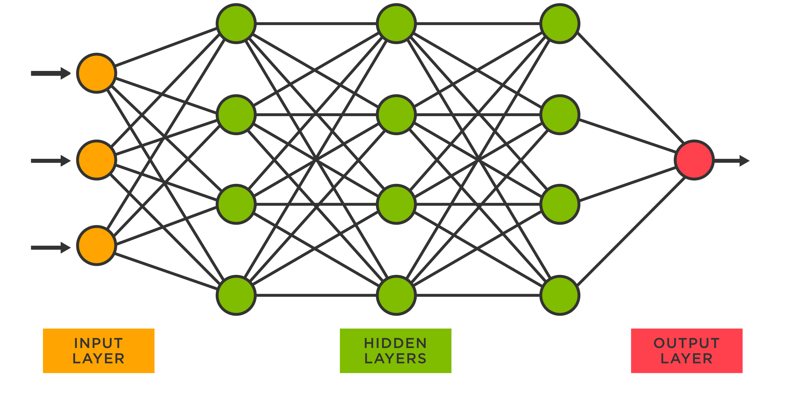
Convolutional Neural Networks
Deep learning is an effective tool for analyzing large quantities of data by using complex algorithms to train machines/computers
Convolutional Neural Networks are specialized types of model that excels at image recognition and capable of learning features of images by themselves
Notes:
// The “deep” aspect comes from the many layers of computation that take place on models that can be very complex.
The term Neural Network is derived from the architecture of our brains and how neurons are passed between synapses depending on the type of information they are carrying // These models help machines learn from repeated exposure to training data. We then have the machine make predictions on new data that is presented to the model
//
These artificial neural networks take an input in the form of numerical data and then pass the data through the model’s “hidden layers”. There are many different types of Hidden layers that serve different functions, but mostly, they work to reduce the number of parameters needed to process the image and therefore processing becomes faster even as it reduces memory requirement and computational cost.
CNNs are playing a major role in diverse tasks/functions like image processing problems, computer vision tasks like localization and segmentation, video analysis, even recognizing obstacles in self-driving cars and speech recognition in natural language processing.

Slide 11
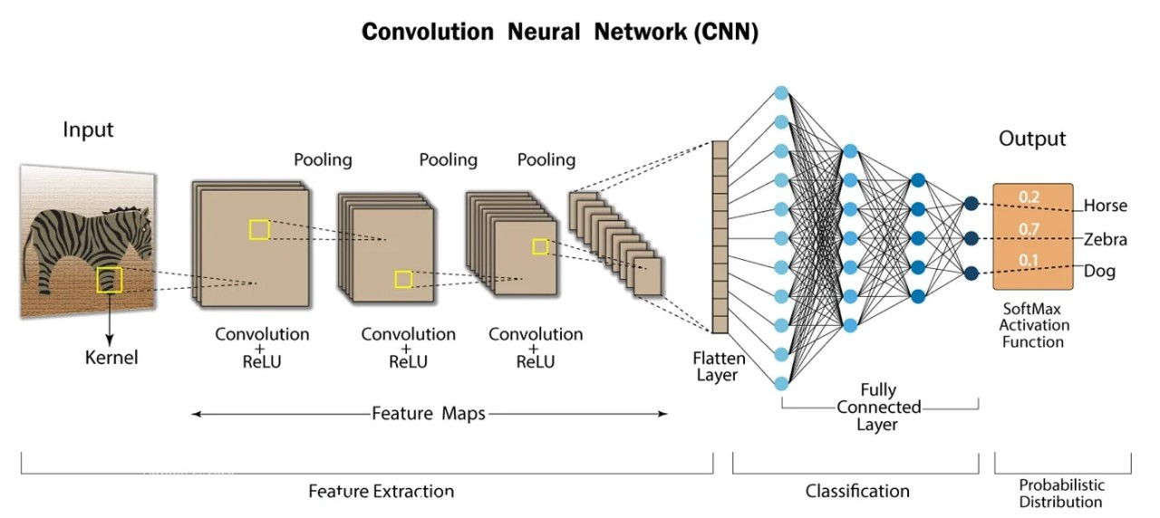
Notes:
Here we can see an example of how this process works. This model is trying to determine whether the subject of a given image is either a dog, horse or zebra.
We start with the input image and, as we discussed before, the image is split into 3 channels (R,G,B). The Kernel or Filter passes over the data (remember it is an array of values between 0 and 1 now) and tries to identify patterns. As the data is being scanned only the filtered parts of the images which meet the “activation criteria” are sent to the next layer. The activation criteria (or feature maps) are what the model is extracting to be the distinct parts of the image that it can classify. The feature maps are then passed through several more layers of that same process, eventually hitting the flatten layer which takes all those complex feature maps and allows them to become input data for a traditional neural network, which is where the machine actually learns the patterns of the data and eventually makes a prediction. At the end of this example, we can see that, based on what the machine has learned, it is assigning 70% chance that the image is of a Zebra. This is the prediction of the model and because we, the humans, organize the data in such a way, it immediately compares its prediction to the actual class of the image. In my case, I built a binary classification CNN, which means that my output layer had to only tell whether an image belonged represented a token or not, yes or no. In the end my model was about 15 layers deep.

Slide 12
Accuracy of the Model
CNN model achieved 99.6% accuracy!
“Imbalanced Model” accuracy score = 98%
🎉
🎉
🎉
🎉
🎉
🎉
Notes:
You may recall that I separated my data in two sets: training and testing. So far in my presentation I’ve been primarily talking about the training data, of which a portion was digitally altered and then passed through my model. This training data can be passed through the model dozens if not hundreds of times depending on the how the model is set up. However, model’s accuracy is measured by how well the model can make predictions on images it has never seen before and that is where the TEST data comes in. Predictions are made on these images and then compared to actual labels (token or not). After a couple rounds of tinkering my CNN eventually reached an accuracy score of over 99%! Now of course, I described earlier how these very sophisticated models were used in ways that were far exceeding the use-case of telling the difference between some cards so its understandable that it would do so well. So, considering this, I decided to give the same CNN a challenge and leave in biasedness originally found in my data to see how this “imbalanced model” would compare and it did just as well with a 98% accuracy score.

Slide 13
Transfer Learning
Pre-Defined Models: models built in the past and proven to be so successful that they are saved for others to load up and use.
ResNet50: a residual neural network made up of a 50-layer convolutional network.
Token Classification Accuracy: 89% +
VGG16: object detection and classification algorithm which can classify images into 1000 different categories with very high accuracy.
Token Classification Accuracy: 99% +
Notes:
The next step in my project was to use pre-defined models with my data set to see if they could achieve the same rates of accuracy as my models had. I used Python code to construct my model and to build the all the layers, however these predefined ones, which are highly successful and often award-winning models, can be accessed and loaded into your code for use.
ResNet model was developed in 2015 for image recognition and won that year's ImageNet Large Scale Visual Recognition Challenge, according to Wikipedia.
The VGG-16 model is a CNN architecture that was proposed by the Visual Geometry Group (VGG) at the University of Oxford in 2014. It consists of 16 layers, which is where the 16 comes from.
Given the high accuracy of my own models and the high accuracy that I expected from these models, I decided to save some time and computational power, Irun these models just a limited number of times, which is why the accuracy score is slightly lower than my own models.

Slide 14
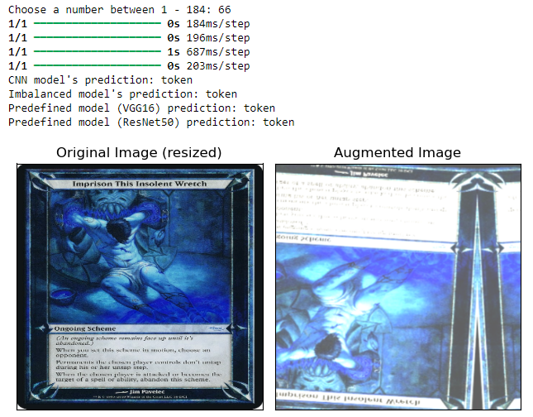
The Final Test
Obtain new images of card types as “play cards”
Conspiracy, Scheme and Phenomena
New function would process the image and then have each model make a prediction
Result: Room for improvement!
Notes:
The final step in the process was to put my 4 models to the test against images that were brand new to them. For this I did some research on other types of Magic cards and found cards that would make it incredibly difficult for the models to tell whether they were tokens are not. I went back to Scryfall web search and scraped and saved the images of cards of the types: Conspiracy, Scheme and Phenomena. These cards are not legal in almost any format as they served very set-specific thematic functions; I’ve never even heard of these let alone seen one in real life. For my business case, it would be highly unlikely that any of these cards would be bought, but in any case, I created a function that would take use a user input to choose an image, apply some augmentation to it have each of the models make a prediction. The expectation was that the models should recognize these as play cards every single time, but you can see in this example that they struggled. Different images provided different results, of course but nothing very concrete that would lead me to believe that the models would be able to handle these exceptions. To improve my models going forward I would add all of these new images to my original training and test data sets so that the model would have an opportunity to learn the features of these cards as they relate to their “play card” label.

Slide 15
Any Questions?
Thank you!

